Slide 1
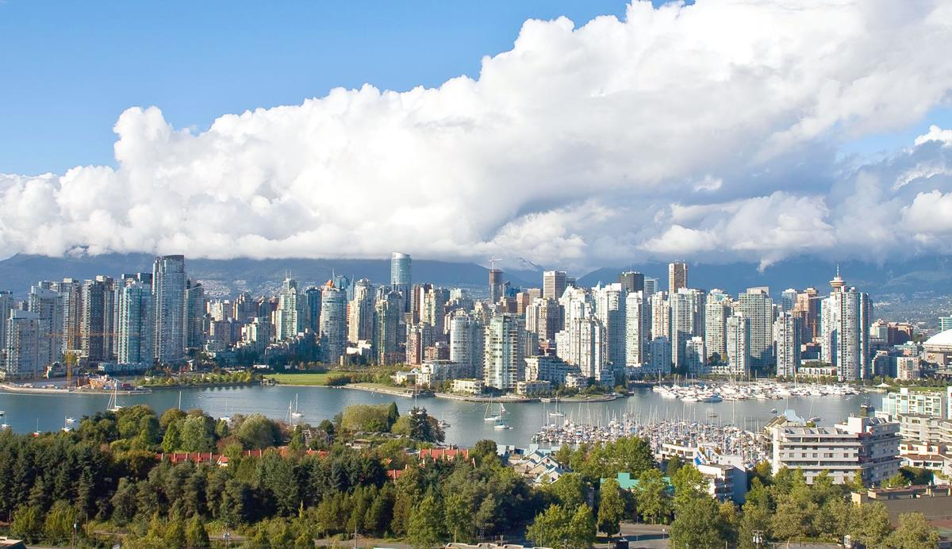
Vancouver
IBM Data Science Capstone Project
- The Battle of Neighborhoods

Slide 2
About Vancouver, Canada
Key facts
Vancouver is a coastal seaport city in western Canada, located in the Lower Mainland region of British Columbia. As the most populous city in the province, the 2016 census recorded 631,486 people in the city, up from 603,502 in 2011. The Greater Vancouver area had a population of 2,463,431 in 2016, making it the third-largest metropolitan area in Canada. Vancouver has the highest population density in Canada, with over 5,400 people per square kilometre, which makes it the fifth-most densely populated city with over 250,000 residents in North America, behind New York City, Guadalajara...
Local time: Pacific Standard Time
Population: 631,486 (2016)
Area: 44.39 sq miles (115 km²)
Nearby airport: Vancouver International Airport, Abbotsford International Airport
Colleges and universities: University of British Columbia, Langara College, Regent College, Emily Carr University of Art and Design, Vanc...
Host of: 2010 Winter Olympics
Mayor: Kennedy Stewart
Notes:
QuickStarter has created an outline to help you get started on your presentation. Some slides include information here in the notes to provide additional topics for you to research.
Summary:
Vancouver is a coastal seaport city in western Canada, located in the Lower Mainland region of British Columbia. As the most populous city in the province, the 2016 census recorded 631,486 people in the city, up from 603,502 in 2011. The Greater Vancouver area had a population of 2,463,431 in 2016, making it the third-largest metropolitan area in Canada. Vancouver has the highest population density in Canada, with over 5,400 people per square kilometre, which makes it the fifth-most densely populated city with over 250,000 residents in North America, behind New York City, Guadalajara, San Francisco, and Mexico City. Vancouver is one of the most ethnically and linguistically diverse cities in Canada: 52% of its residents are not native English speakers, 48.9% are native speakers of neither English nor French, and 50.6% of residents belong to visible minority groups.
More key facts:
Colleges and universities: University of British Columbia, Langara College, Regent College, Emily Carr University of Art and Design, Vancouver Community College, Columbia College, The Art Institute of Vancouver, Vancouver School of Theology, Carey Theological College, Canadian College, Ashton College, Great Northern Way Campus, St. John's College, University of British Columbia, Native Education College, Educacentre College, The Art Institute of Vancouver, The International Culinary School, CDI College, Vancouver

Slide 3
Contents
Introduction
Data
Methodology and Results
Conclusion and Discussion

Slide 4
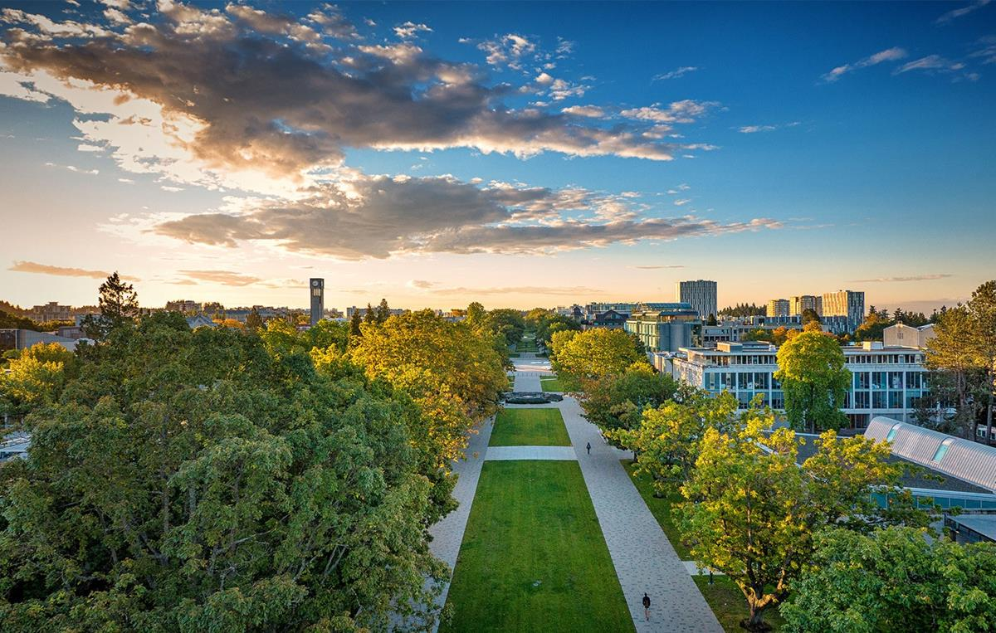
Introduction
A new student is moving to Vancouver, Canada to study at University of British Columbia. To help her decide where to live, s/he would like to know which neighborhood has which characteristics and how each neighborhood differs from each other.
Other potential interested parties may include real estate agents, housing developers, etc.

Slide 5
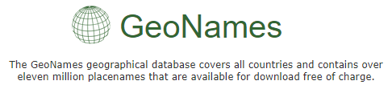

data
In courtesy to GeoNames (https://www.geonames.org), a downloadable csv file is available and contains all Canadian postal codes and corresponding geospatial data.
We also utilize the Foursquare, which is the location data provider we practiced using in this course, API to explore the neighborhoods and segment them.
Notes:
Consider talking about:
Theatre, dance, film and television
Libraries and museums
Visual art
Music and nightlife

Slide 6
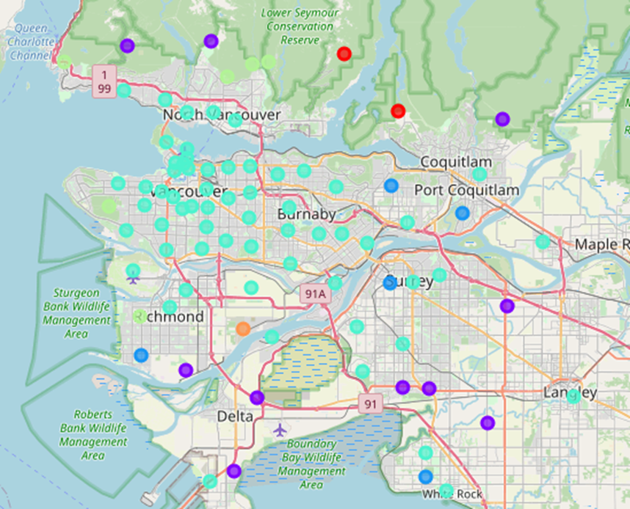
Methodology and results
Top 20 venues within 1000-meter radius of each neighborhood in Greater Vancouver.
1,223 venues in 219 unique categories across our target 88 neighborhoods.
Ranging from ATM, various types of restaurants, public facilities, to yoga studios, etc.
Top 10 venue categories in each neighborhood.
k-means clustering to cluster the neighborhoods into 6 clusters.

Slide 7
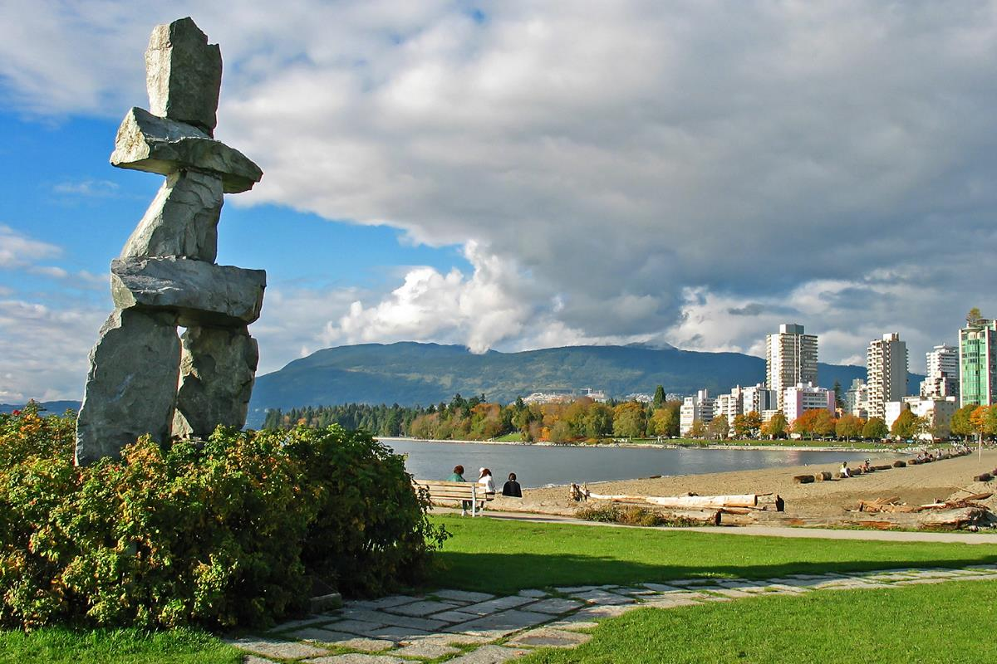
conclusion
Neighborhood clustering based on Foursquare venues data effectively display each neighborhood’s venues or lifestyle characteristics.
For potential client interest, we could enhance neighborhood segmentation by including other neighborhood-specific socio-economic data. E.g. income level, education level, crime rate, housing prices, etc.
Notes:
Consider talking about:
Theatre, dance, film and television
Libraries and museums
Visual art
Music and nightlife

